Slide 1
WP5 webinar:
CERN, the LHC and the ATLAS experiment
Christine Kourkoumelis NKUA/IASA

Slide 2
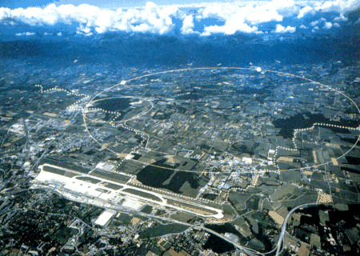
CERN and the Basic Research
The research seeks for answers to fundamental questions: What are the constituents of matter and what are the interactions between them
At the same time pushes the cutting-edge technology and trains the future scientists
23 member states, 17,000 users from 800 institutes across the world
Unique facilities (accelerators and experiments)

Slide 3

Our description of matter: the SM
The key component missing for 50 years!!!
What do we know?
We have the «Ideal»
Standard Model (SM) ?
3 quark families
3 lepton families
4 « unifiable » forces
mγ=0
mZ,W~100 GeV
Why?

Slide 4
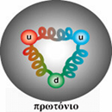
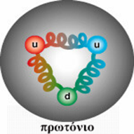
What was needed? A powerful accelerator
q
q
W
H
W
q
q
M_{H} ̴ 1000 GeV
E_{W} ≥ 500 GeV
Eq ≥1000 GeV
Ep ≥6000 GeV
LHC: Design beam energy 7 (now 6.5) TeV

Slide 5
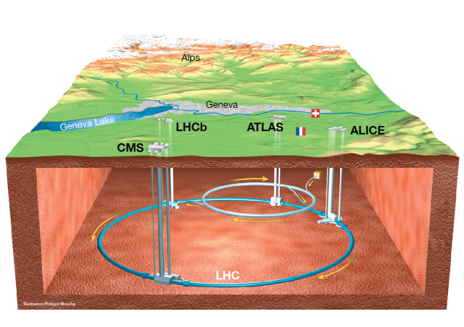
The Large Proton Collider (LHC)
The LHC is located at the Swiss-French borders,
100m below the surface.
and it is a:
Large: 27km circumference;
Hadron: accelerates mainly bunches of protons;
Collider: the proton bunches collide.

Slide 6
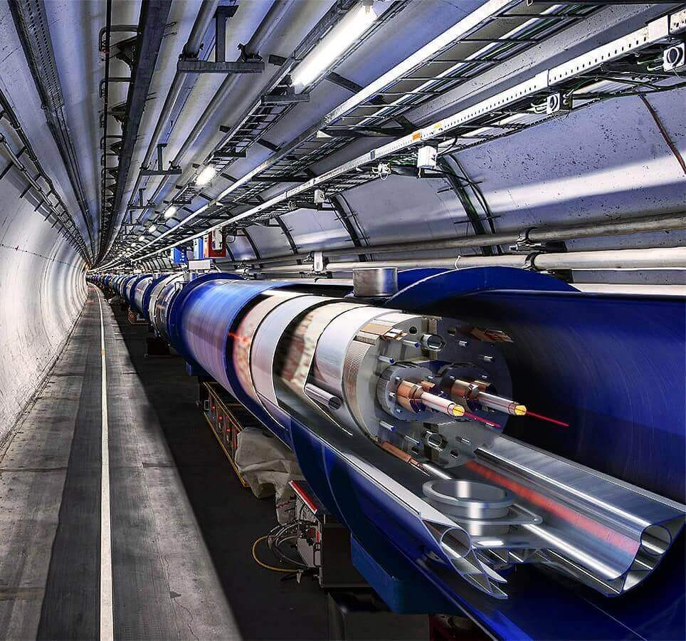
WP5: Citizen Science at the LHC
Two vacuum pipes in which the proton bunches accelerate in opposite directions.
The pipes intersect at four points
along the LHC circumference.
At those points, protons collide at very high energy.
x
x
x
x

Slide 7
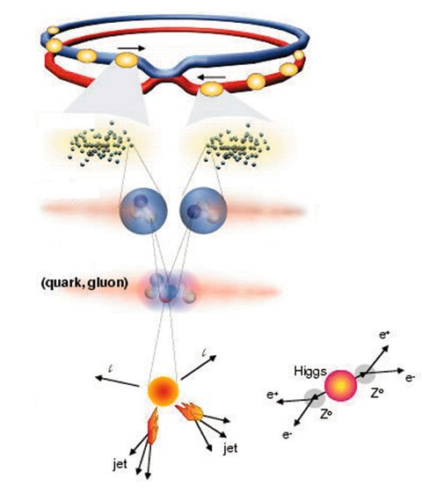
Proton Collisions
Proton bunches collide every 25ns.
Each bunch contains more than 100 billion protons.
Tens of protons interact but only 1 out of many millions(trillions) “events” is interesting.

Slide 8

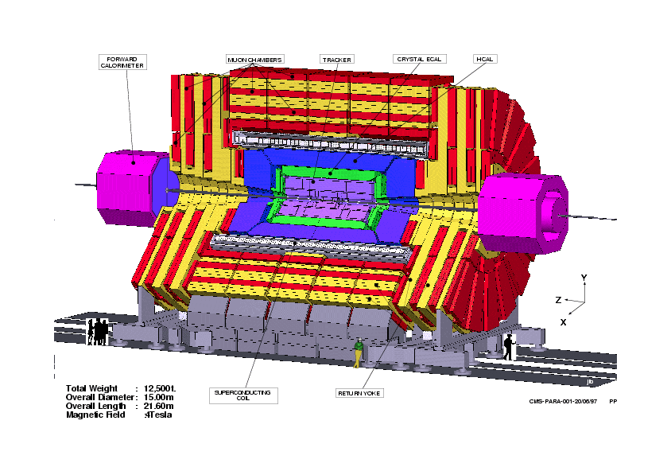
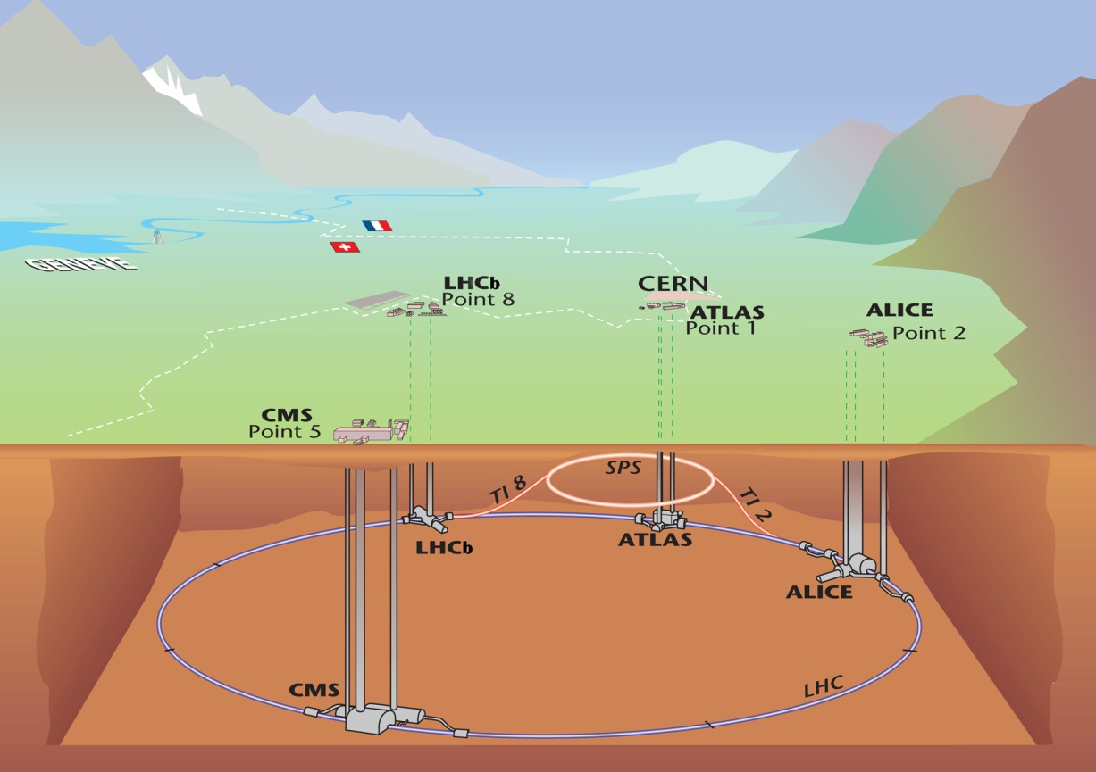
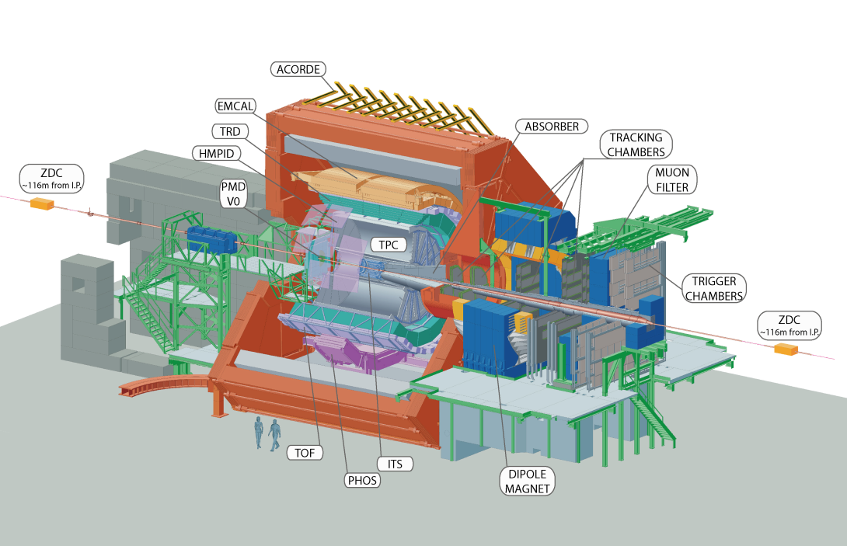
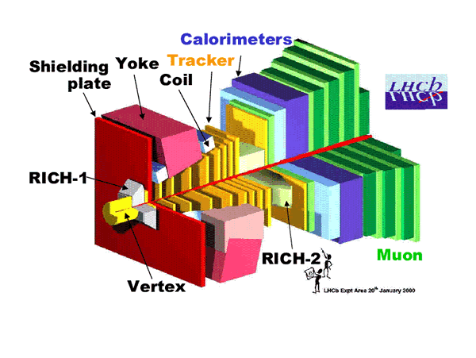
ATLAS
CMS
LHC
ALICE
LHC-B

Slide 9
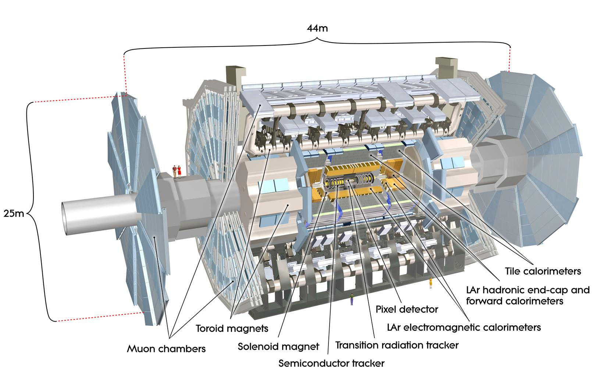
The ATLAS experiment :
A huge multi-purpose detector

Slide 10
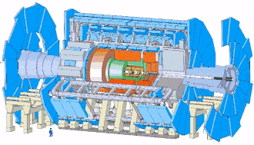
ATLAS is divided into sub-detectors (like skins of an onion)
Here are shown in different colours
Each one serves a different identification/measurement purpose as will be shown in the demonstrator

Slide 11
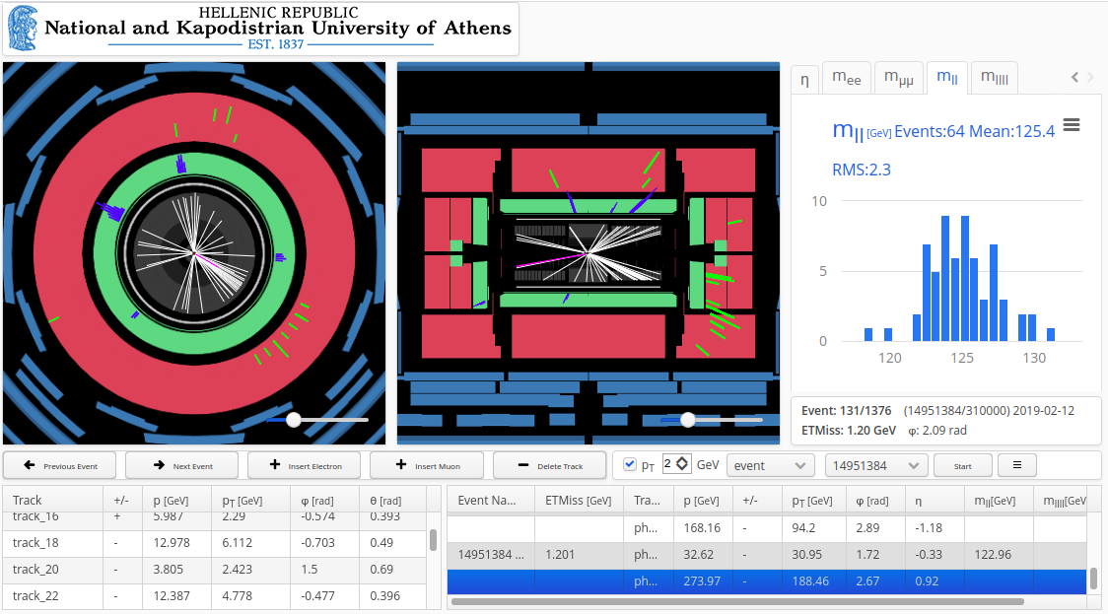
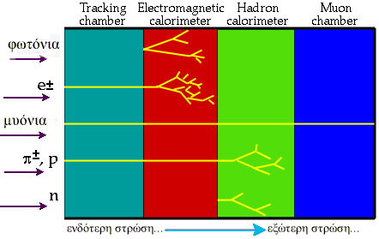
The different sub-detectors and the visualization tools

