Slide 1
Research Infrastructures for citizen scientists
The EC perspective
Marina Manzoni
Joint Research Center
European Commission

Slide 2
EC common approach to Citizen Science in Research and Innovation
Citizen Science at the core of the European Research Area (ERA)
Key features for citizen and societal engagement in Horizon Europe
Carried our from different angles e.g. R&D Projects, Research Studies, Policy driven EU wide initiatives
Notes:
Council Conclusions:
“further develop and implement the “plastic pirates” citizen science campaign in cooperation with the proposed Mission on Healthy Oceans, Seas, Coastal and Inland Waters… organise at least every two years a Europe-wide Citizen Science Campaign… in synergy with Horizon Europe missions”
2021 Horizon Europe WIDERA call, closed 23 September 2021
HORIZON-WIDERA-2021-ERA-01-60: A capacity-building and brokering network to make citizen science an integral part of the ERA (EUR 4m)
HORIZON-WIDERA-2021-ERA-01-61: Supporting and giving recognition to citizen science in the ERA (EUR 5m)

Slide 3
Key features for citizen and societal engagement in Horizon Europe
Open science, which includes citizen and societal engagement, is the modus operandi of the entire programme
Societal engagement as part of the excellence criterion under methodology during proposal evaluation
Co-design and co-creation, and engagement of citizens and civil society organisations, are mainstreamed across the programme
One of the nine pathways to impact (KPI-6) starts with citizens and end-users co-creating knowledge and innovations, with the goal of developing solutions and knowledge that are relevant and taken up by society

Slide 4
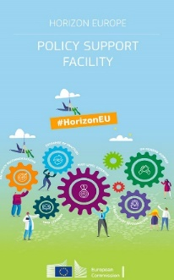

EC Projects and Initiatives: RTD
Mutual Learning Exercise on Citizen Science
Mutual learning exercises (MLE) focus on specific R&I challenge of interest to MSs and ACs
MLE on Citizen Science (CS) proposed from MSs to
strengthen their CS national policies and initiative by exchanging lesson learnt and best practice
exploit synergies and upscale suitable (cross-) national CS initiatives across the ERA
Exercise supported by EC Policy Support Facility and external experts started January 2022
11 MSs/ACs: Germany, Slovenia, Austria, Belgium, France, Hungary, Portugal, Romania, Italy, Sweden and Norway
CS MLE Topics:
Introduction and overview on citizen science
Ensuring good practices and impacts
Maximising the relevance and excellence of citizen science
Enabling environments and sustaining citizen science
Scaling up citizen science
Notes:
Policy Support Facility
Mutual learning exercise (MLE) on citizen science e recently launched to support and expand citizen science activities in and between European states
Request by the trio presidency Germany Slovenia Portugal
11 mss acs expressed their interest to this exercise and take active part in it

Slide 5
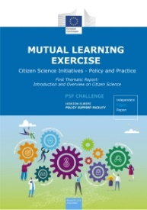
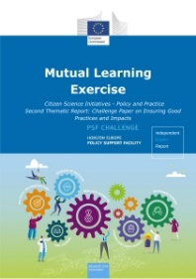
Initiatives and Reports: RTD
Additional Readings
RTD Policy Initiatives
https://ec.europa.eu/research-and-innovation/en/statistics/policy-support-facility/mutual-learning-exercise-citizen-science-initiatives-policy-and-practice
Thematic Report
Introduction and Overview on Citizen Science
Challenge Paper
Ensuring Good Practices and Impacts

Slide 6
EC projects and initiatives: CONNECT
OPEN SCIENCE CLOUD
Cos4Cloud, a European Horizon 2020 project: Prototyping new innovative services
https://cordis.europa.eu/project/id/863463
Key features
Open science challenges
Generated from different providers
Fit-for-purpose
Notes:
COS4CLOUD aims to design, prototyped and implemented services that address the Open Science challenges shared by Citizen observatories of biodiversity,
The innovative services will be designed, prototyped and implemented for improving the data and information quality using deep machine learning, automatic video recognition, advanced mobile app interfaces, and other cutting-edge technologies, based on data models and data protocols validated by traditional science.
The new services will provide mechanisms to ensure the visibility and recognition of data contributors and the tools to improve networking between various stakeholders through the integration of CS products, generated by different providers, following open standards to ensure their interoperability, and offered in agile, fit-for-purpose and sustainable site available through EOSC hub, including a discovery service, to both traditional and citizen scientists. The design of new services will be user oriented, engaging a wide range of stakeholders in society, government, industry, academia, agencies, and research to co-design service requirements. As a result, COS4CLOUD will integrate citizen science in the European Open Science Cloud, bringing Citizen Science (CS) projects as a service for the scientific community and society at large.

Slide 7
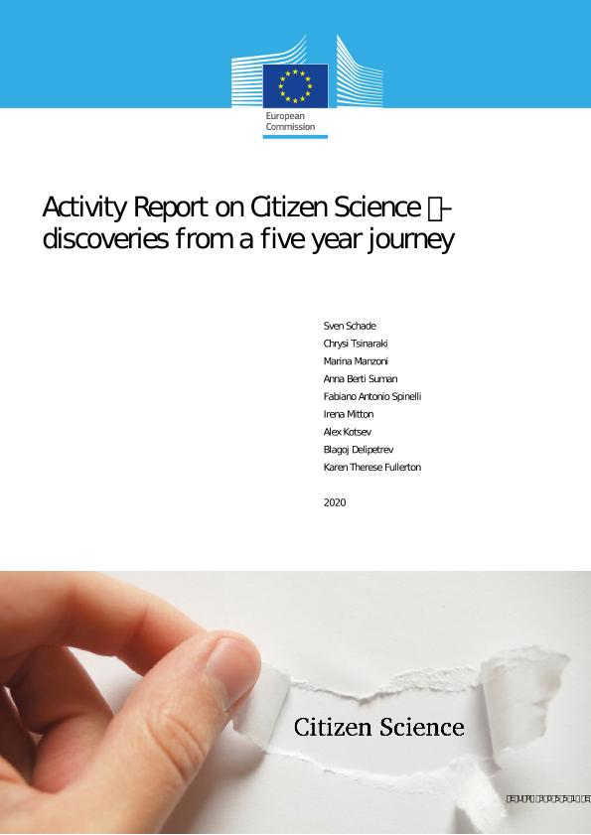
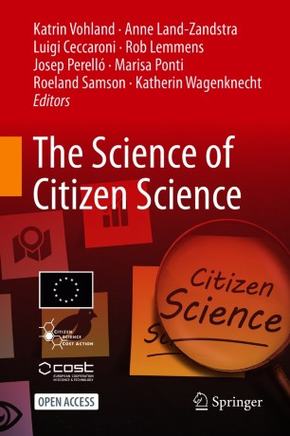
Initiatives and Research: JRC
Competence Centre on Participatory and Deliberative Democracy
https://knowledge4policy.ec.europa.eu/participatory-democracy/about_en
Activity Report on Citizen Science – discoveries from a five year journey
https://publications.jrc.ec.europa.eu/repository/handle/JRC123500
Staff Working Document – Best Practices in Citizen Science for Environmental monitoring
https://ec.europa.eu/environment/legal/reporting/pdf/best_practices_citizen_science_environmental_monitoring.pdf
Exploring legitimization strategies for contested uses of citizen-generated data for policy
https://publications.jrc.ec.europa.eu/repository/handle/JRC121251
COST : The Science of Citizen Science
https://link.springer.com/book/10.1007/978-3-030-58278-4
Notes:
Competence Centre on Participatory and Deliberative Democracy
provide services, guidance and tools to support the development of socially robust policy through citizen engagement practices.
Long lasting cooperatina and activities in support to Biodiveristy
Involvement of Citizens to environmental policy making
CS in Jurisdiction = Citizens rights for court cases
CGD for Digital Governance (eg NGMs)
Colaboration with scientific internatinal communities (COST and international associations)

Slide 8
Joint Research Center
Research Highlights
Wider scope = Citizen Generated Data
Fit-for-Purpose = Different stakeholders perspective
Spreading and Scaling = Contextualisation
Portability = Mainstreaming of common approaches
Legitimisation = CS in Jurisdiction
Notes:
JRC looks at CS from a wider angle and portability is evolving rapidly (e.g. aplied to different areas and policies –urban agriculture, energy, trensport, etc.)
Led Partners Policy DGs (RTD and CONNECT) to develop and uptake common approaches and main features of CS, and its mainstreaming into R&I programmes paving the way to current projects and activities (see above)
Results/findings through Research activities and initiatives carried out through
International Research (e.g. COST)
Studies and Publications
Science for Policy Reports
Staff Working Documents

Slide 9
KEY MESSAGES on CS
Wide and complex Ecosystem
    Different Purposes (decision making, data management, monitoring, reporting, etc.)
    Different Areas/domains
    Different Stakeholders (varied value chain)
    Different Operational Levels (Governance, processes, data, technology, etc.)
Guiding principle
  Understand objectives of data use and underlying governance models first, in order to define relevant and adaptive infrastructure ecosystems built on active co-creation processes and approaches
Sustainability = optimising resources by leveraging the potential of emerging technologies, and empowered Communities
Notes:
Decision

Slide 10
Citizen Science & Gamifications: food for thoughts
Handling massive data through
Computer Power & large Communities
BORDERLINE SCIENCE
https://www.youtube.com/watch?v=zoWIOEm4EAw
https://www.youtube.com/watch?v=L_mH6Ak_Ny0
MMOS – Massive Multiplayer Online Science
https://www.redbull.com/int-en/videos/massive-multiplayer-online-science
Notes:
To stimulate some thinking beyond the more conservative content of all previous slides
CS through Gamification
MMOS is a Swiss company that connects scientific research and video games as a seamless gaming experience.

Slide 11
THANK YOU
EUROPEAN COMMISSION
JOINT RESEARCH CENTER – Growth & Innovation
B6 – Digital Economy
e-mail: Marina.Manzoni@ec.europa.eu
EU Science Hub: https://joint-research-centre.ec.europa.eu/index_en

