Slide 1
How to use cosmic rays in the study of geosciences and archaeology
WEBINAR
May 11, 2021, 15:00 CEST

Slide 2
What are cosmic rays ?
Cosmic rays are high-energy particles that travel through space at nearly the speed of light.
Illustration of cosmic rays reaching and interacting with the Earth’s atmosphere, producing air showers where muons are generated.
*
REINFORCE webinar | www.reinforceeu.eu
2

Slide 3
What are cosmic rays ?
Cosmic ray particles hit the Earth’s atmosphere at the rate of about 1000 per square meter per second.
Illustration of cosmic rays reaching and interacting with the Earth’s atmosphere, producing air showers where muons are generated.
*
REINFORCE webinar | www.reinforceeu.eu
3

Slide 4
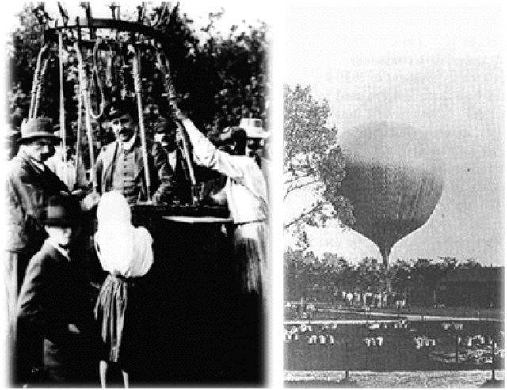
When were cosmic rays discovered ?
In 1912, physicist Victor Hess flew a series of high-altitude balloon flights (up to 5,300 meters).
*
REINFORCE webinar | www.reinforceeu.eu
4

Slide 5
When were cosmic rays discovered ?
In 1912, physicist Victor Hess flew a series of high-altitude balloon flights (up to 5,300 meters).
He discovered that “a radiation of very great penetrating power enters our atmosphere from above”.
*
REINFORCE webinar | www.reinforceeu.eu
5

Slide 6
When were cosmic rays discovered ?
In 1912, physicist Victor Hess flew a series of high-altitude balloon flights (up to 5,300 meters).
He discovered that “a radiation of very great penetrating power enters our atmosphere from above”.
The Sun was not the only source.
*
REINFORCE webinar | www.reinforceeu.eu
6

Slide 7
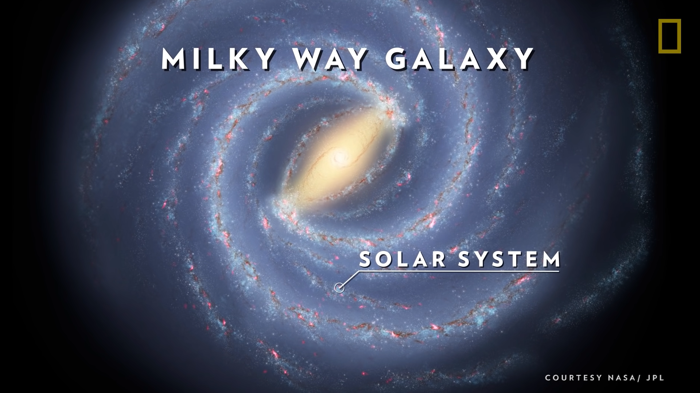
Where do cosmic rays come from ?
This is not yet fully known.
*
REINFORCE webinar | www.reinforceeu.eu
7

Slide 8
Where do cosmic rays come from ?
This is not yet fully known.
Nearly all of them come from outside the solar system, but from within the Galaxy.
*
REINFORCE webinar | www.reinforceeu.eu
8

Slide 9
Where do cosmic rays come from ?
This is not yet fully known.
Nearly all of them come from outside the solar system, but from within the Galaxy.
The very highest energy cosmic rays may be of extragalactic origin.
*
REINFORCE webinar | www.reinforceeu.eu
9

Slide 10
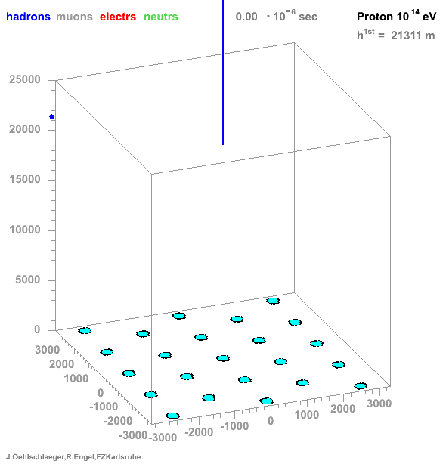
What happens when cosmic rays reach the Earth ?
Cosmic rays interact with the atmosphere and produce Extensive Air Showers (EAS).
*
REINFORCE webinar | www.reinforceeu.eu
10

Slide 11
What happens when cosmic rays reach the Earth ?
Cosmic rays interact with the atmosphere and produce Extensive Air Showers (EAS).
About 100 muons per square meter per second reach the Earth’s surface.
*
REINFORCE webinar | www.reinforceeu.eu
11

Slide 12
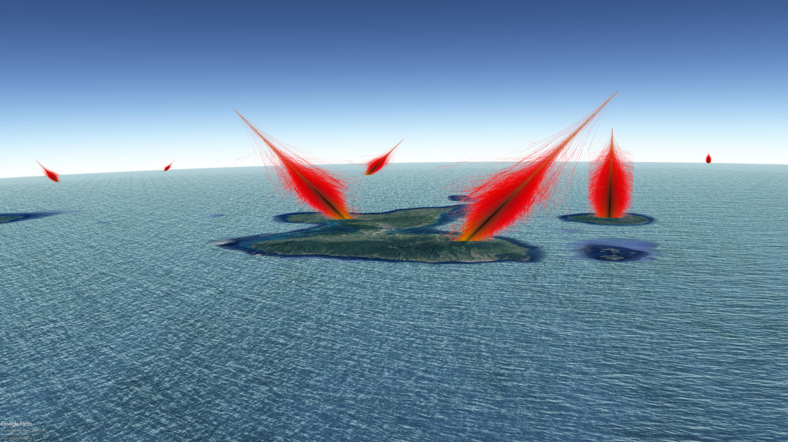
How do we use cosmic rays to study geological bodies ?
*
REINFORCE webinar | www.reinforceeu.eu
12

Slide 13
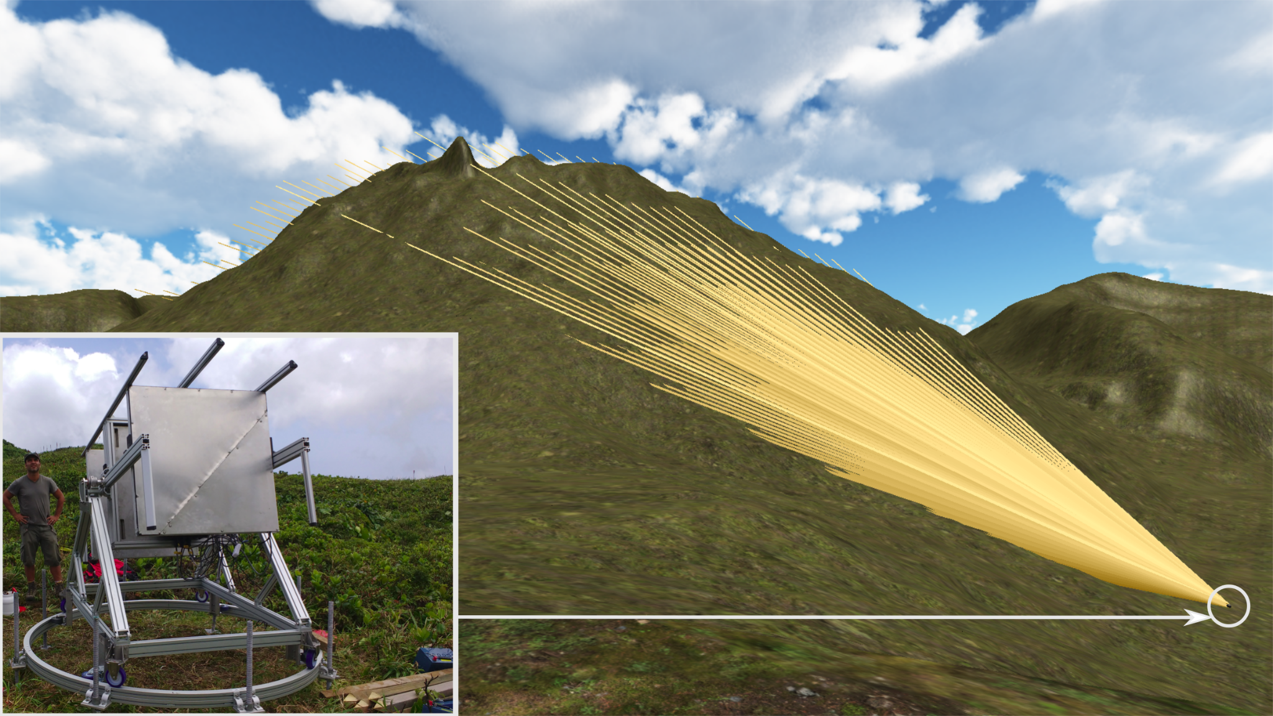
How do we use cosmic rays to study geological bodies ?
*
REINFORCE webinar | www.reinforceeu.eu
13

Slide 14
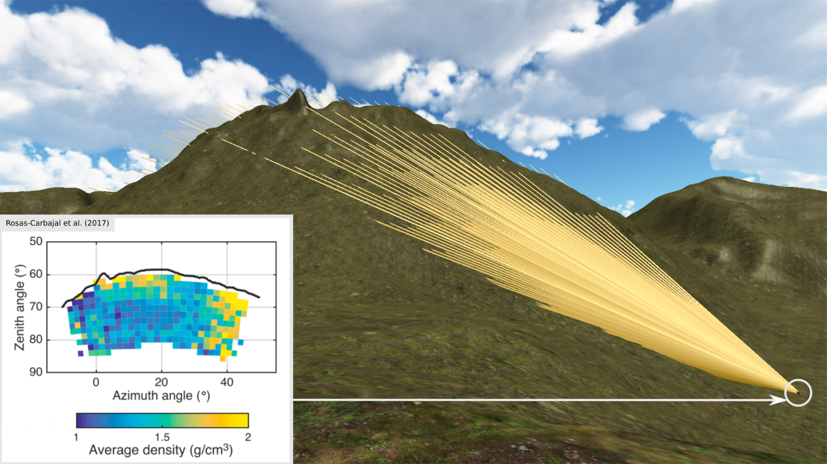
How do we use cosmic rays to study geological bodies ?
*
REINFORCE webinar | www.reinforceeu.eu
14

Slide 15
Join our community
www.reinforceeu.eu
company/reinforceeu
@ReinforceEU

